Slide 1

miRFlow Software
Flow Chart illustrating the workflow, unit(s), and integration between units and system(s)

Slide 2
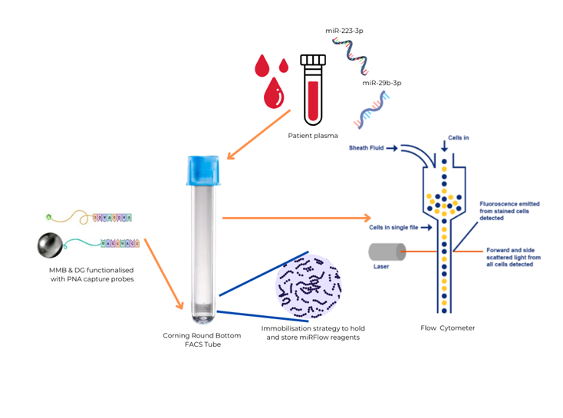
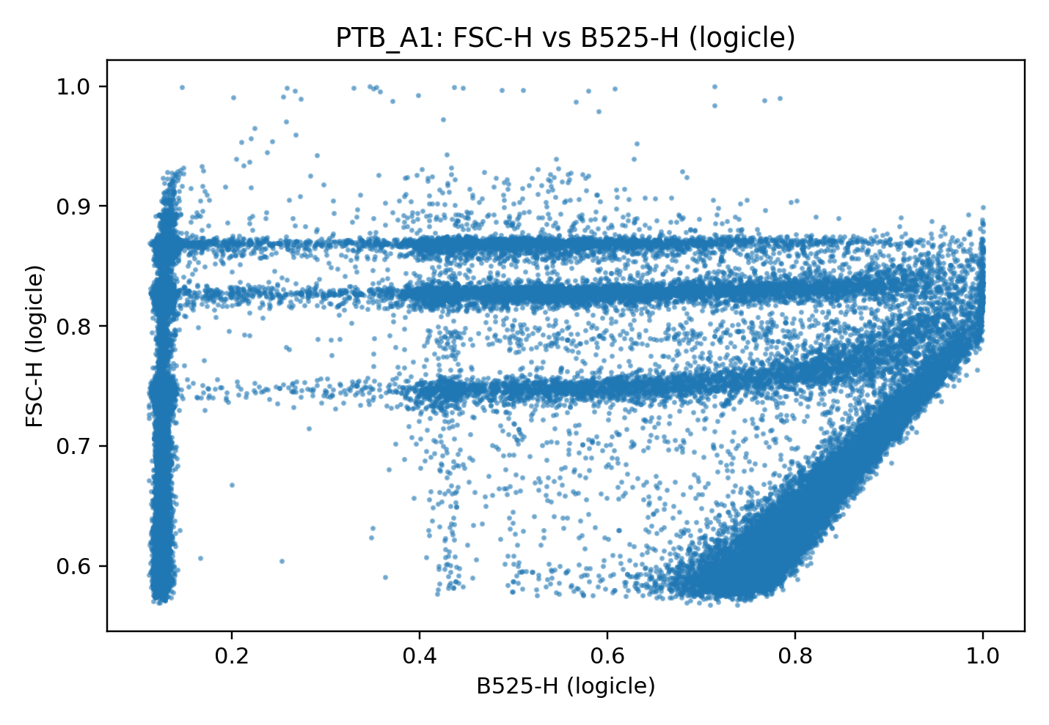
Overview of the overarching goal

Slide 3
Data Acquisition
FC Input:
Raw .fcs files (controls + patient)
(B) Confocal Microscopy Input (Potentially):
Per-event fluorescence intensity
Spatial fluorescence heterogeneity
Image-derived binding metrics
(look up a bit more on what these terms mean contextually)
Software Context
Quantifies miRNA-based sandwich complexes
Converts assay fluorescence signals into clinically resolvable weighted scores/ratios (how likely is the miRNA presence)
Developed with reproducibility & traceability in consideration
FC Data Visualiser Module
Read every .fcs file on assigned folder
Auto-detect FSC-H (size) and B525-H (fluorescence) channels by default; channels can be changed if poor default resolution
Apply logicle transformation to each or fallback to asinh transformation (hyperbolic sine function)
Save 1D and 2D plots per file as .PNG with:
Size vs density for MMB (1D)
Size vs density for DG (1D)
Fluorescence vs density for MMB (1D)
Fluorescence vs density for DG (1D)
Size vs Fluorescence for MMB (2D)
Size vs Fluorescence for DG (2D)
Results in transformed, standardised event-level data replicating FlowJo (Gold standard for FC data analysis)
Imports:
__future__.annotations – Enables modern type hint handling.
Pathlib – Robust Windows path handling (input/output folders).
sys / os / math – Runtime info, controlled exits, and grid layout calculations.
NumPy – Numerical arrays, masking, transformations, downsampling.
Pandas – DataFrame handling of parsed .fcs data.
Matplotlib (Agg backend) – Generate and save PNG scatter plots without GUI.
fcsparser – Read .fcs files into DataFrames.
flowutils.logicle (optional) – Logicle transform for flow cytometry scaling (with asinh fallback).
FCS Output Organiser Module
Scans predefined folders containing previously generated:
MMB 2D plots
DG 2D plots
MMB 1D plots (size + fluorescence)
DG 1D plots (size vs fluorescence)
Groups related PNGs together in same folder
Saves additional ‘All samples’ overview grid .PNG containing all plots arranged together:
DG Fluorescence Overview
DG Size Overview
DG 2D Overview
MMB Fluorescence Overview
MMB Size Overview
MMB 2D Overview

Slide 4
Branch A: Efficient Signal Segmentation (FC)
Goal: Control-derived gating for event classification
Branch B: Image-based Event Weighting (ML)
Goal: Multi-modal classification of events to improve accuracy (work to be done)
Global Gating Module:
Reads all .fcs files from defined folder
Auto-detects the FSC-H and B525-H channels
Applies logicle transformation with asinh fallback (same as FC Data Ingestion & Visualiser Module)
Derives per-file gating boundaries from Gaussian KDE-based density calculations
Outputs (statistical reasoning not extensively included here):
Global FSC-H window from controls (MMB size) → [Lower Bound, Upper Bound]
Global B526-H window from controls (DG fluorescence) → [Lower Bound, Upper Bound]
Outputs is saved as a .JSON file titled ‘gate_summary_by_type.json’
Imports:
Pathlib for robust Windows paths
NumPy/Pandas for data handling
Matplotlib (Agg backend) to save PNGs without opening GUI windows
SciPy Gaussian KDE for smooth density estimation
SciPy find_peaks for robust detection of subtle bumps on DG fluorescence
fcsparser to load .fcs into a DataFrame

Slide 5
MMB Boundaries Extractor Module:
Loads all .fcs files in specified input folder
Filters to MMB-only files labelled like: 3MMB_1.fcs, 6MMB_2.fcs, 8MMB_3.fcs
Auto-detects size channel (FSC-H)
Applies Logicle transform
For each file:
Builds a Gaussian KDE of FSC-H
Finds the dominant peak (density corresponding to highest FSC-H)
Computes the LEFT shoulder FSC-H value where KDE drops to 5% of peak density
Saved as ‘start_fsc’ for that bead population
For each bead class, the median ‘start_fsc’ is computed
Thus, the recommended boundaries received are as follows, integrating with the global MMB size window (gate_summary_by_type.json):
MMB 3 = [Lower Bound of Global MMB, median_start_fsc of MMB 6]
MMB 6 = [median_start_fsc of MMB 6, median_start_fsc of MMB 8]
MMB 8 = [median_start_fsc of MMB 8, Upper Bound of Global MMB]
Quality Check: median_start_fsc = Lower Bound of Global MMB 3
Output is a .JSON file titled ‘mmb_fsc_thresholds.json’ consists of per bead size and per file breakdown metrics
Imports:
__future__.annotations – Enables modern type hint handling.
Pathlib – Robust filesystem path handling (input/output directories, JSON path).
argparse – Command-line argument parsing (input/output paths, thresholds, parameters).
json – Export structured threshold results to JSON.
NumPy – Numerical operations, arrays, medians, quantiles, masking.
Pandas – DataFrame handling of parsed .fcs data.
SciPy (gaussian_kde) – KDE density estimation for dominant peak and shoulder detection.
fcsparser – Read .fcs flow cytometry files into DataFrames.
flowutils.logicle (required) – Logicle transformation for FSC scaling (mandatory for threshold derivation).

Slide 6
GMM Probabilistic Clustering Module
For each patient .fcs file:
Apply Logicle transform (flowutils) with asinh fallback as back-up
Apply ROI gating (control-derived global windows) from ‘gate_summary_by_type.json’ :
Size in [MMB_LOW, MMB_HIGH]
Fluorescence in [DG_LOW, DG_HIGH]
Assign bead boundaries deterministically using FSC thresholds as dictated in ‘mmb_fsc_thresholds.json’
For each sample(patient) bead size, fit 1D GMM posterior probabilities on fluorescence only within the ROI events:
Default: 3 components (only MMB/ sandwich MMB/ multi MMB aggregate)
Live patient DG fluorescence data will be used to determine a low mean (q25), mid-mean (q50), and high-mean (q75)
Soft Assigment → low-mean: only MMB, mid-mean: sandwich MMB, high mean: mutli-MMB aggregate
Results in 9 clusters as follows:
MMB-3 → only, sandwich, multi-aggregate
MMB-6 → only, sandwich, multi-aggregate
MMB-8 → only, sandwich, multi-aggregate
Exception A:
if too few events for stable 3-comp, fall back to 2-comp (only MMB/sandwich MMB), multi=0
Exception B:
q25, q50, and q75 chosen heuristically, the percentile boundaries can be changed as needed
for very unimodal distributions (fluorescence), if q25, q50, and q75 are too close, they will be adjusted by the introduction of ε(1e-6) to prevent model from collapsing
Outputs:
per-patient 2D plot (ROI only): x = B525-H (fluorescence), y = FSC-H (size), colored by 9 clusters + legend
MMB gate/boundary lines for interpretability
per-patient JSON summary (counts + posterior-weighted expected counts, efficiencies)
one overview GRID png with all patient plots
a master CSV across all patients (one row per patient x bead size + overall row, i.e., everything in .JSON but collated and easy to follow form)
Imports:
__future__.annotations – Enables modern type hint handling.
Pathlib – Robust filesystem path management (JSON, FCS, output folders).
os / sys / json / math – Runtime info, controlled exits, JSON I/O, grid layout calculations.
dataclasses (@dataclass) – Structured storage of per-bead GMM fit results.
typing (Dict, Tuple, List, Optional) – Static type clarity for function signatures.
NumPy – Numerical arrays, masking, percentiles, posterior calculations, downsampling.
Pandas – Create and export master CSV summary tables.
Matplotlib (Agg backend) – Generate and save per-patient cluster plots and overview grid PNGs without GUI.
fcsparser – Read .fcs flow cytometry files into DataFrames.
scikit-learn (GaussianMixture) – Perform 1D GMM clustering for tri-state bead classification.
flowutils.logicle (optional) – Logicle transformation for cytometry scaling (with asinh fallback).

Slide 7
Branch B Modules and Logic (to be determined)
Integration & Scoring Module:
Goal: Final ‘risk’ metric computation based on miRNA-sandwich signals weighed against relevant intensity scores secured from (confocal) imaging
Machine Learning will be deployed to train model on the correlation between signals and images
Strong definition of the miR 223-3p/miR 29b-3p ratio alongside the relevant confidence intervals to prevent over or under estimation of signals
Final Product:
Ux work to be conducted in close association with NHS clinicians before developing the software ‘app’
Ux will mainly focus on how the miR 223-3p/miR 29b-3p ratio will be presented, i.e., green alert if sample ratio +- 50% away, yellow/orange alert if sample ratio +-25% away, red alert if sample ratio +-10% away
App can be downloaded from relevant marketplace by clinicians
.fcs files gathered from pathology labs and fed into the app which will:
Analyse all the files, generate visualisations, .JSONs, and master .CSV files (audit-readiness)

